Slide 1
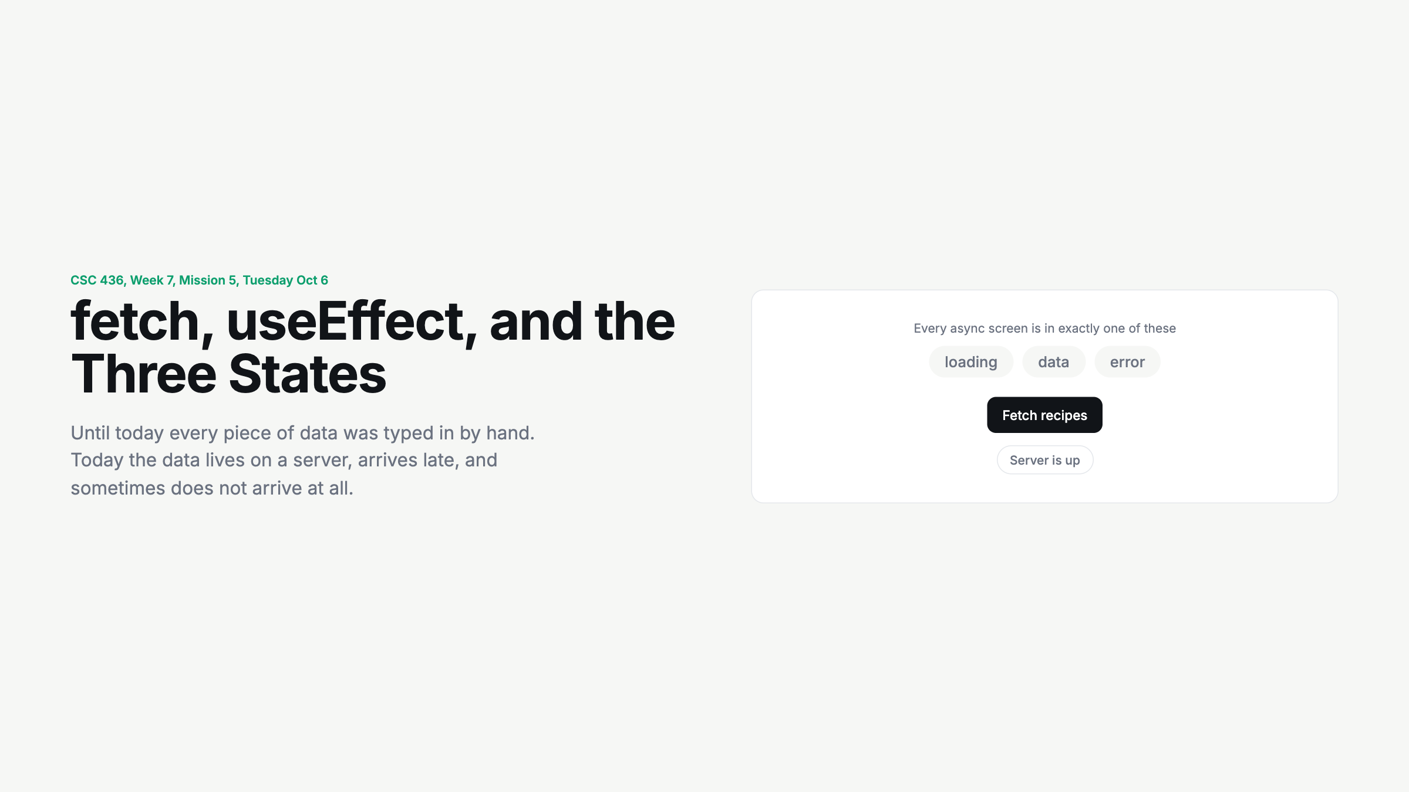
Notes:
Click Fetch recipes with the server up, then flip it down and fetch again. Three chips, one lit at a time. Say the sentence: every async screen is in exactly one state.

Slide 2
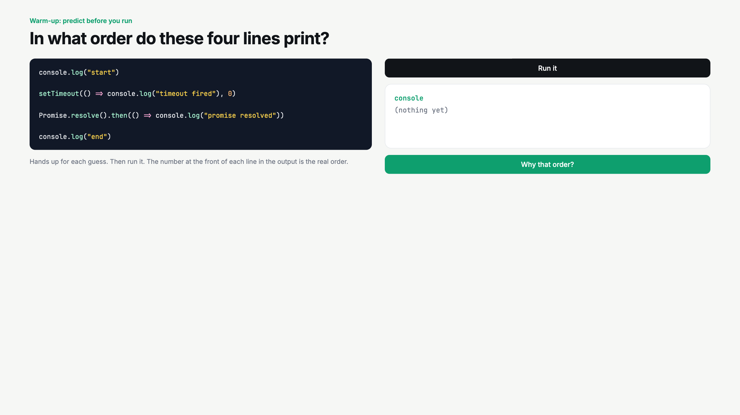
Notes:
Vote before running. Most say start, end, timeout, promise. The promise beats the timeout. One sentence on microtasks, then move on. The point is just: fetch results come later.

Slide 3
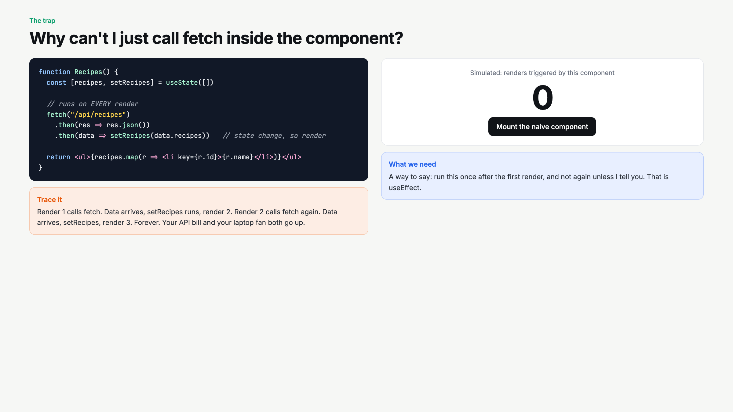
Notes:
Trace the loop out loud before mounting. Then click. The counter runs away. Ask: what would stop it? A way to run code once. Introduce the word effect.

Slide 4
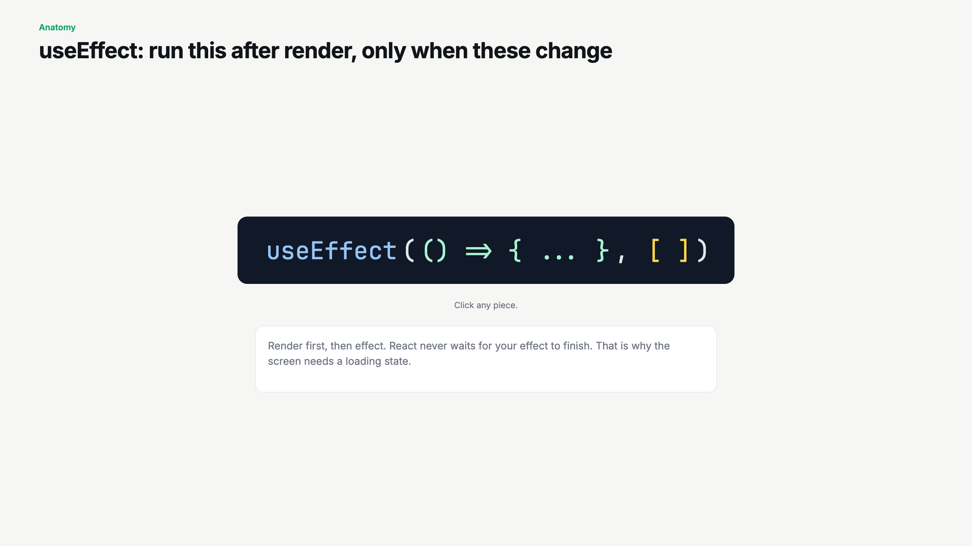
Notes:
Click the pieces in order: the function, then the array. Say render first, then effect. That is why the screen is blank for a moment.

Slide 5
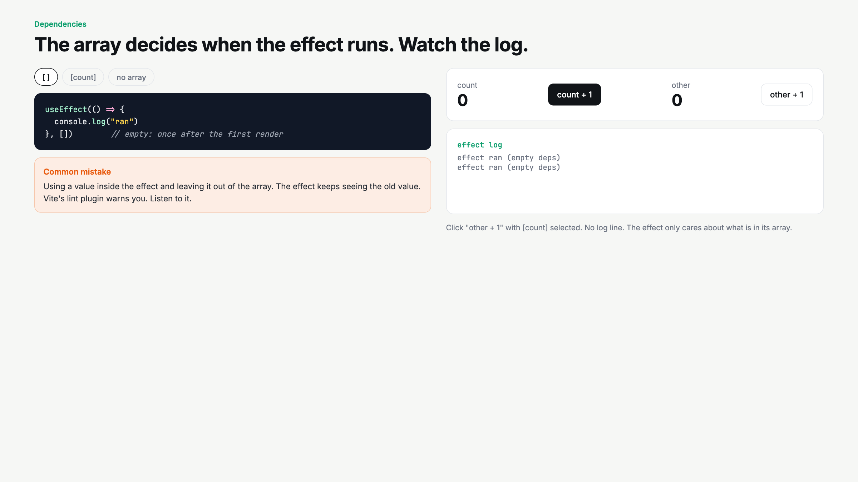
Notes:
Do [ ] first: click count, nothing logs. Then [count]: click count, logs, click other, nothing. Then no array: everything logs. Leave it on [count].

Slide 6
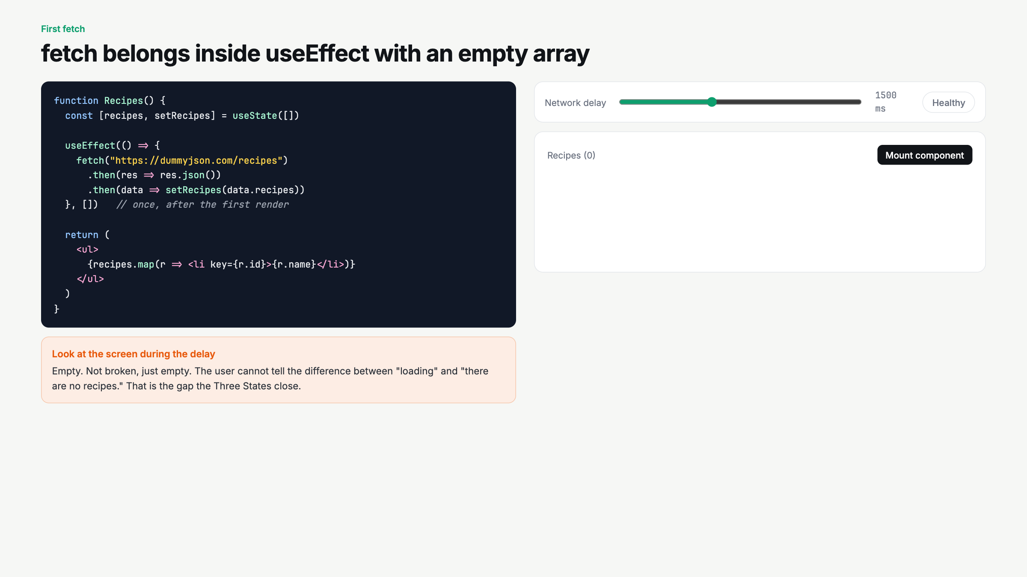
Notes:
Set delay to 3000 before mounting. Stare at the blank list together. Ask: is it loading or empty? Nobody can tell. That is the problem.

Slide 7
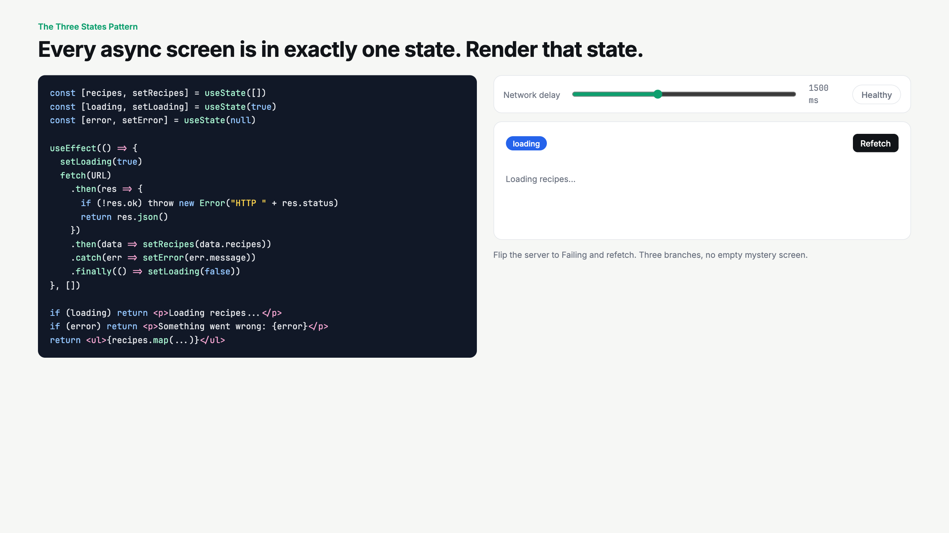
Notes:
This is the slide. Refetch healthy, then failing. Three branches. Write loading / error / data on the board and leave it up for the rest of the semester.

Slide 8
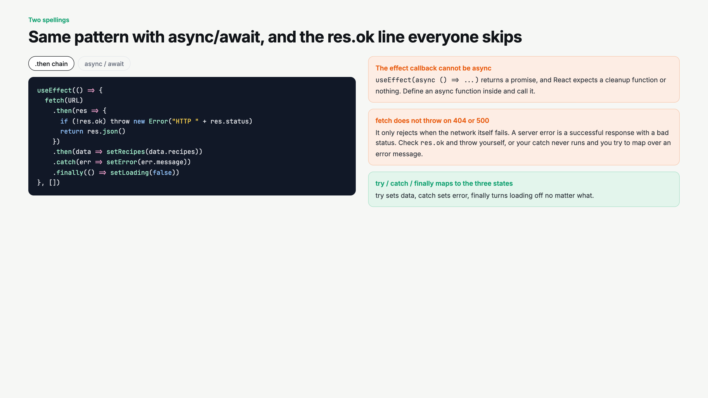
Notes:
Deliberate mistake beat in the live code: delete the res.ok check, break the URL to /recipez, show that catch never fires and the map crashes instead.

Slide 9
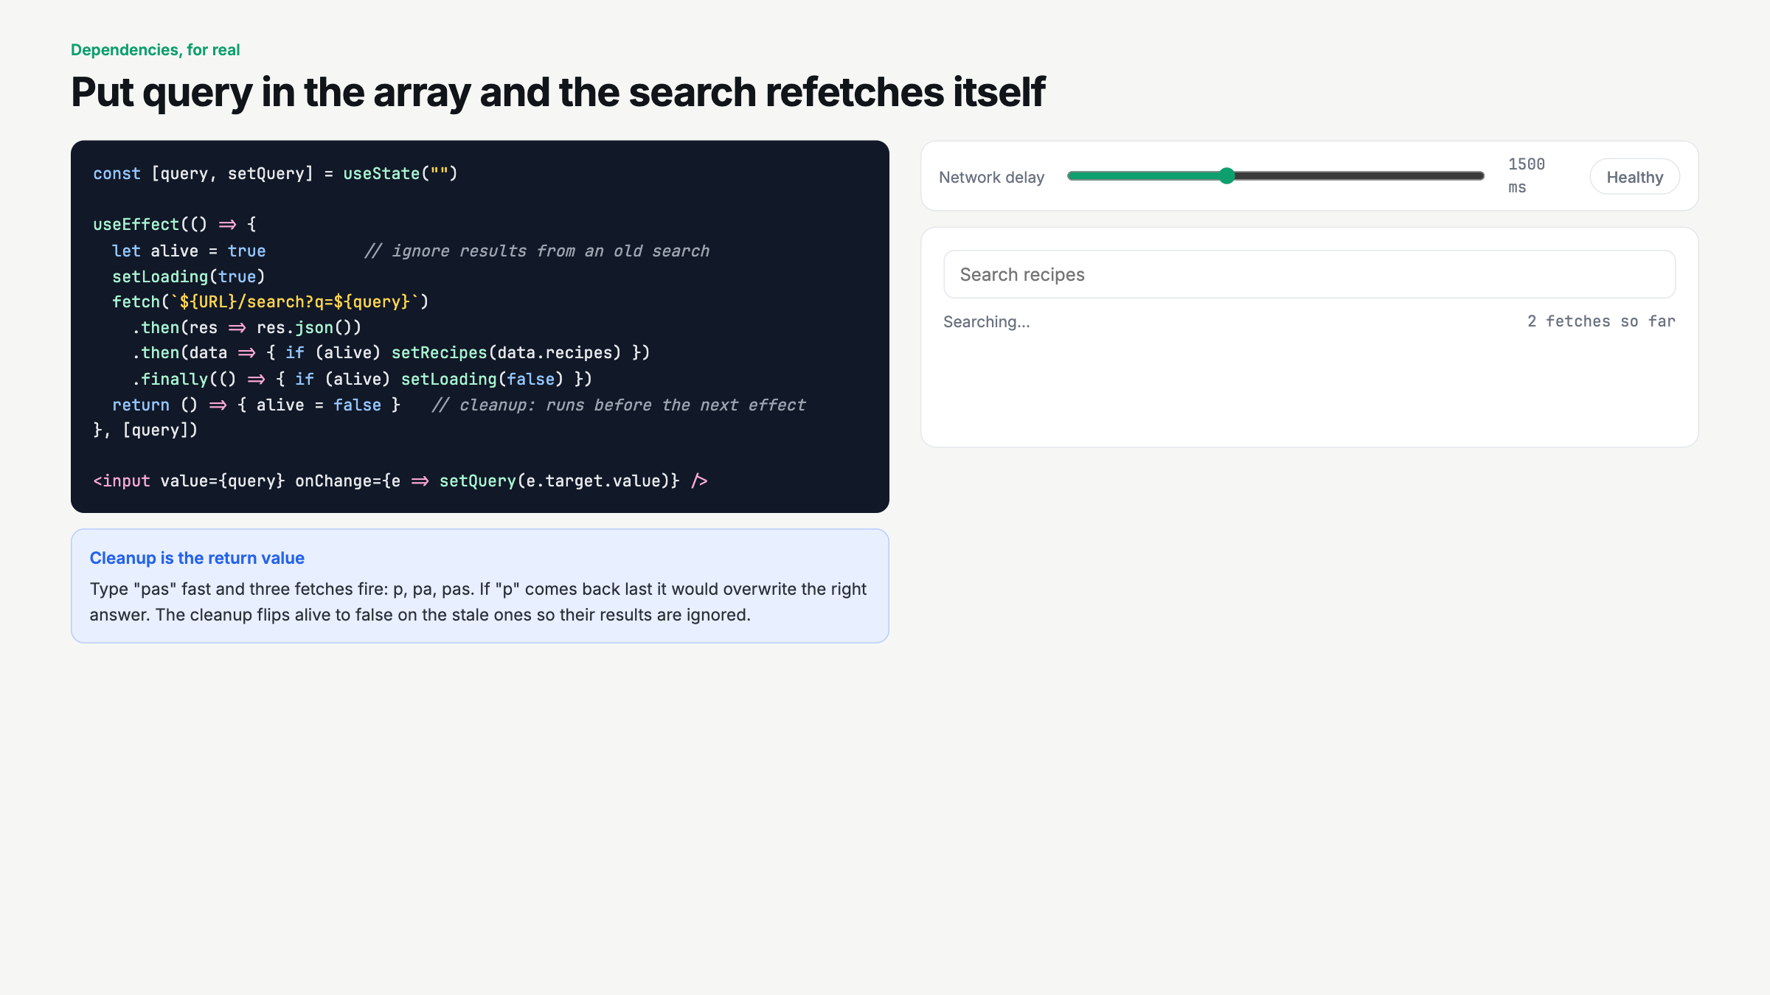
Notes:
Set delay to 2500, type pasta fast. Watch the fetch counter. Explain alive. Then clear the box to show the empty state, the fourth state nobody plans for.

Slide 10
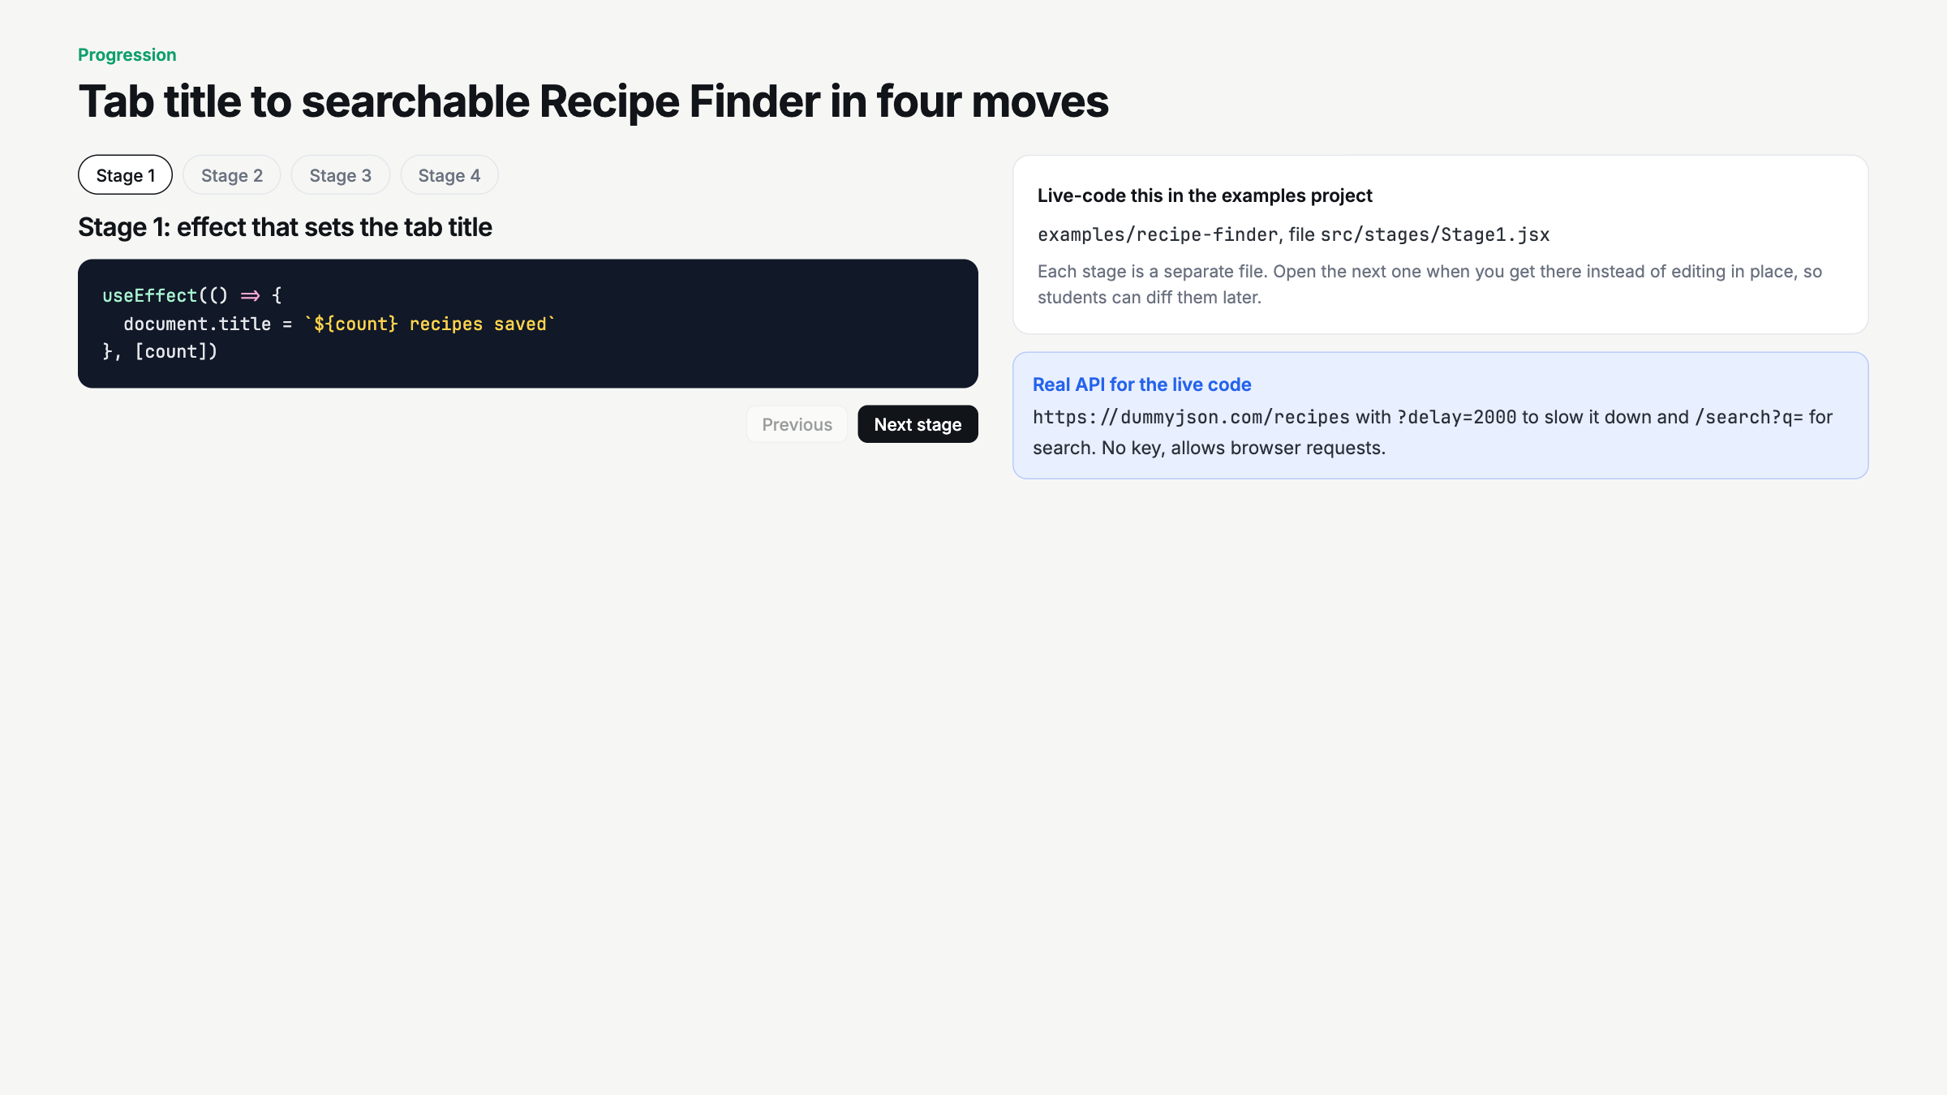
Notes:
Open examples/recipe-finder in the editor. Stages 1 to 4 live against dummyjson with ?delay=2000. If wifi is bad, the deck demos still work because they are faked.

Slide 11
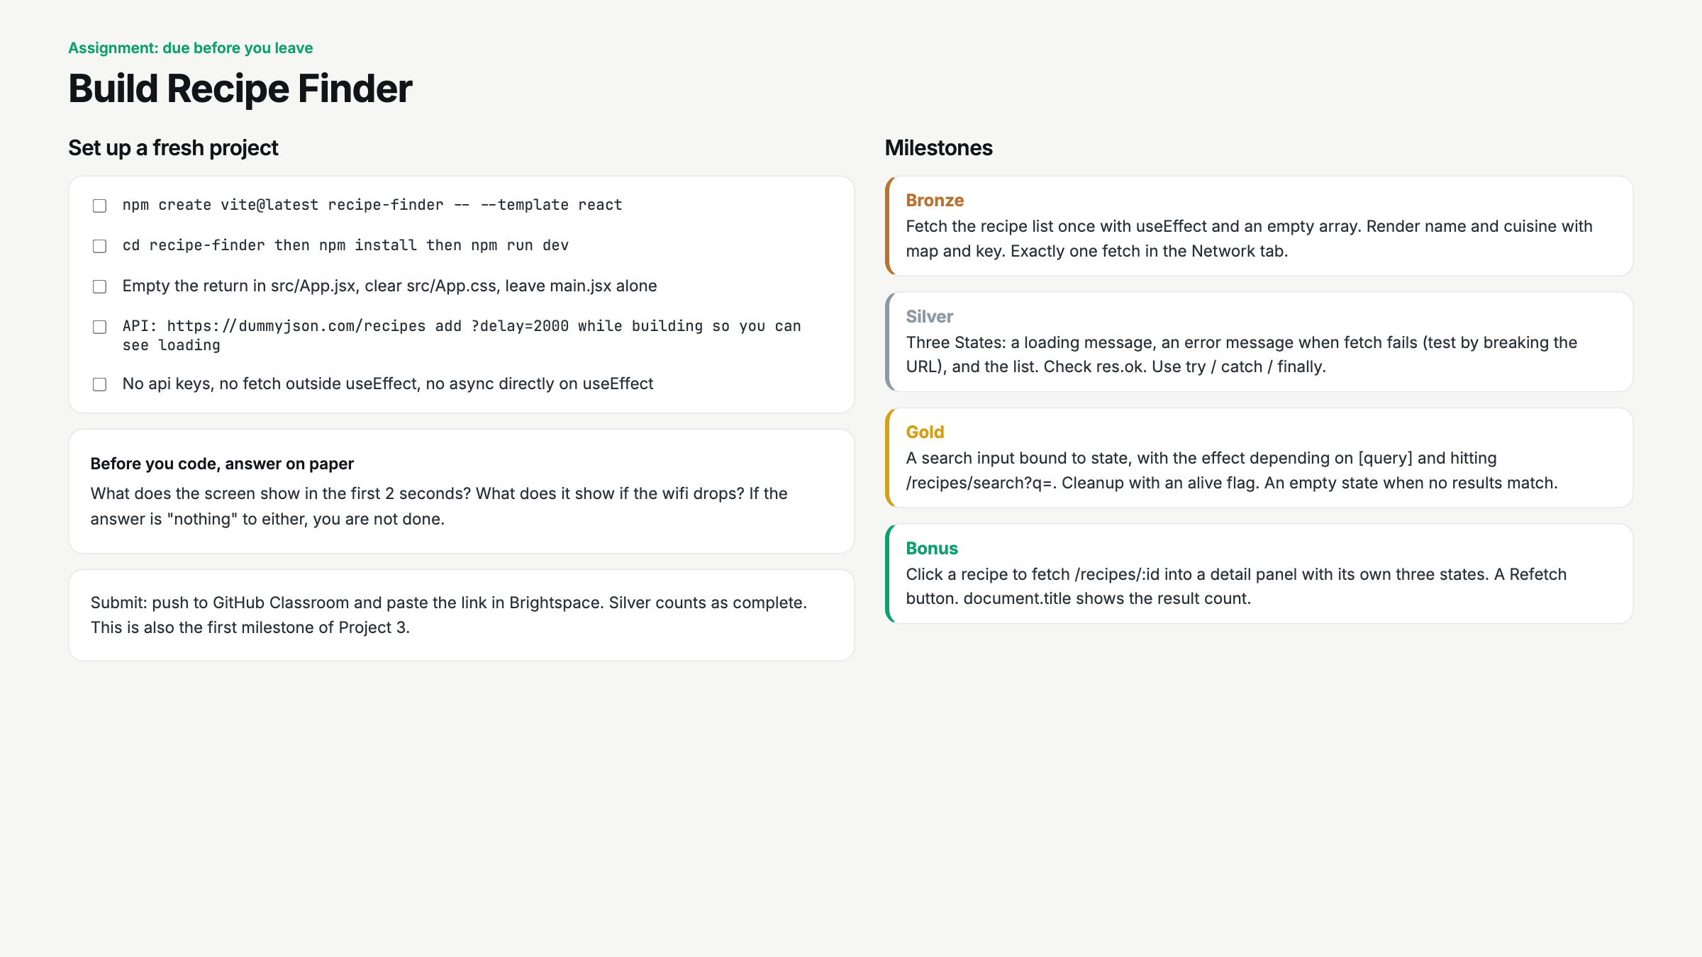
Notes:
Paper question first. Start a 25 minute timer. Circulate for fetch outside useEffect, missing [] (watch the Network tab), and async directly on useEffect.

Slide 12
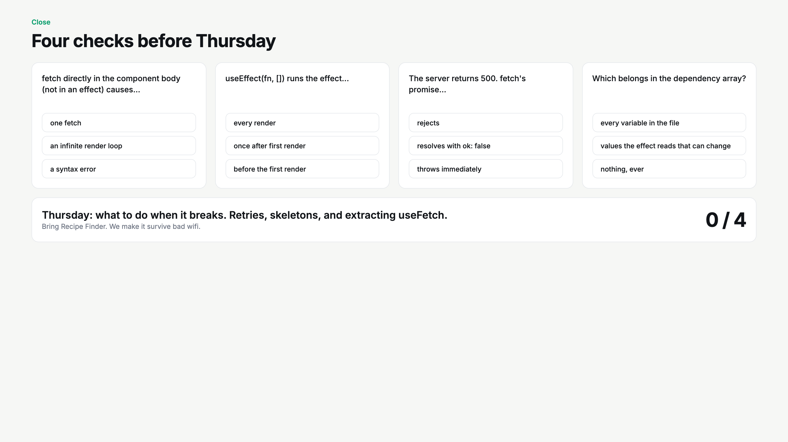
Notes:
Hands up per question. Q3 is the one. fetch does not reject on 500. Tease Thursday: retries, skeletons, useFetch.

